Slide 1
Physical Model

Slide 2
Physical Model
Physical modeling is database software specific, meaning that the objects defined during physical modeling can vary depending on the relational database software being used.
Designed and developed to be fully dependent of Database, data storage locations or technologies
Physical data model represents how the model will be built in the Database such as Oracle, MySQL, SQL Server, etc.
A physical database model shows all table structures, including column name, column data type, column constraints, primary key, foreign key, and relationships between tables.
Designed and Developed by an Database Administrator (DBA), and intended for Database Developers and DBA

Slide 3
Steps for Physical Data Model
Convert entities into tables.
Convert relationships into foreign keys.
Convert attributes into columns.
Modify the physical data model based on physical constraints / requirements.

Slide 4
Features of a physical data model
Specification all tables and columns.
Foreign keys are used to identify relationships between tables.
Denormalization may occur based on user requirements. (Conditions Apply……)
Physical considerations may cause the physical data model to be quite different from the logical data model.

Slide 5
Physical Model for different Databases
Physical data model will have some differences for different Databases. Some of its examples are as follows:
Some Data types for a column are different between Oracle and SQL Server
Varchar is same data type for Oracle & SQL Server, but the max size limits are different.
Composite keys concept is accepted by all databases, but the max limit on number of columns that can make one composite key differs for different databases.
Unique Constraint behaves differently in different databases.
In Referential integrity On Delete Cascade is supported by all databases, but On Update Cascade is NOT supported by all.

Slide 6
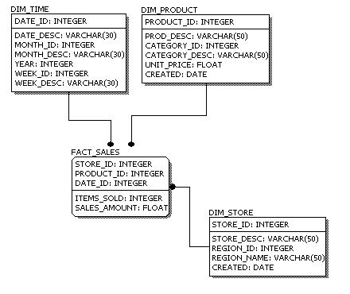

Slide 7
Logical Model Vs. Physical Model
Entity names are now table names.
Attributes are now column names.
Data type for each column is specified. Data types can be different depending on the actual database being used.

